Slide 1

UNIT 7
Time of technology:
A blessing or a curse?

Slide 2
Unit 7 Time of technology:
A blessing or a curse?
Learning objectives
Opening up
Listening to the world
Speaking for communication
Further practice in listening
Wrapping up
Fun time

Slide 3

Learning objectives
1
talk about technology around as
2
listen for agreement and disagreement
3
express essentiality
4
talk about experiences and feelings of playing computer games

Slide 4

Opening up
1
Work in pairs and discuss the questions.
How often do you and your partner do these things? Write O for often, S for sometimes or N for never. Then discuss your answers with your partner.
____ Sending a postcard
____ Using your mobile (phone)
____ Sending a text message
____ Writing a blog
____ Chatting online
____ Sending a fax
____ Updating your webpage
____ Checking your email
____ Using an Internet phone (e.g. Skype)

Slide 5
Opening up
1
Work in pairs and discuss the questions.
How often do you and your partner do these things? Write O for often, S for sometimes or N for never. Then discuss your answers with your partner.
S
____ Sending a postcard
Nowadays, people seldom write letters or send postcards. I’m no exception. Only when I am off to a new and wonderful place will I send souvenir postcards to my family and friends.

Slide 6
Opening up
1
Work in pairs and discuss the questions
How often do you and your partner do these things? Write O for often, S for sometimes or N for never. Then discuss your answers with your partner.
____ Using your mobile (phone)
O
I use my mobile phone all the time. I talk to people, or send text messages or use WeChat. I can’t live without my mobile phone.

Slide 7
Opening up
1
Work in pairs and discuss the questions.
How often do you and your partner do these things? Write O for often, S for sometimes or N for never. Then discuss your answers with your partner.
O
____ Sending a text message
I send text messages quite a lot because it is fast, cheap and convenient.
N
____ Writing a blog
I never write blogs because I haven’t started my own blog yet.

Slide 8
Opening up
1
Work in pairs and discuss the questions.
How often do you and your partner do these things? Write O for often, S for sometimes or N for never. Then discuss your answers with your partner.
O
____ Chatting online
I often use WeChat to chat online with my family, friends or classmates. I love WeChat. I can send not only text message, but also pictures, voice messages and videos. The best thing of WeChat is that it’s free.

Slide 9
Opening up
1
Work in pairs and discuss the questions.
How often do you and your partner do these things? Write O for often, S for sometimes or N for never. Then discuss your answers with your partner.
S
____ Sending a fax
I don’t fax a lot, but sometimes I have to fax some important documents.

Slide 10
Opening up
1
Work in pairs and discuss the questions.
How often do you and your partner do these things? Write O for often, S for sometimes or N for never. Then discuss your answers with your partner.
S
____ Updating your webpage
I built my own webpage about one year ago. At first I updated my webpage every day. But now I am pretty busy, so I spend much less time on it. I update it about once a week.

Slide 11
Opening up
1
Work in pairs and discuss the questions.
How often do you and your partner do these things? Write O for often, S for sometimes or N for never. Then discuss your answers with your partner.
O
____ Checking your email
I check emails frequently because I have got a lot of emails from friends, classmates, teachers or my school. Some of them are very important and need prompt response, so I check emails every day.

Slide 12
Opening up
1
Work in pairs and discuss the questions.
How often do you and your partner do these things? Write O for often, S for sometimes or N for never. Then discuss your answers with your partner.
S
____ Using an Internet phone (e.g. Skype)
Sometimes I use an Internet phone to talk with friends who are abroad for further study. It is fast and convenient, and more importantly, it costs much less than long-distance calls.

Slide 13
Listening to the world
Sharing
Listening
Viewing

Slide 14
Listening to the world
Sharing
1
Watch a podcast for its general idea.
The podcast is mainly about people’s attitudes toward technology, what items of technology they have, and what items are indispensable to them.
2
Watch Part 1 and fill in the blanks.
enjoy
live without
plan my life
listening to music

Slide 15
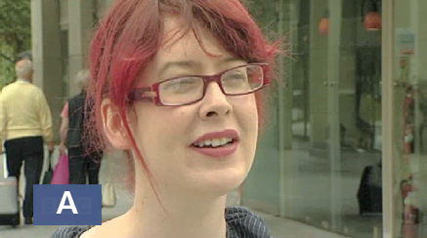
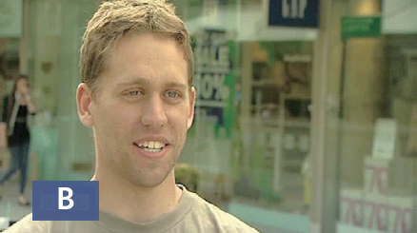
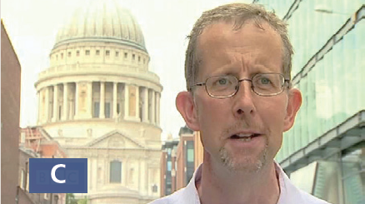
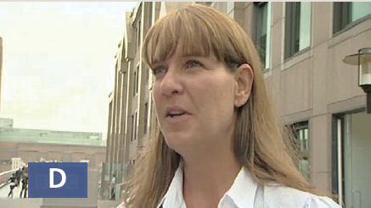
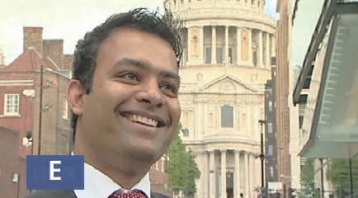
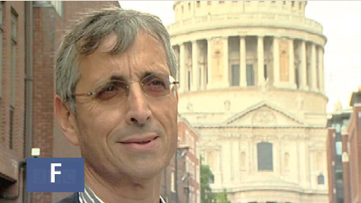
Listening to the world
Sharing
3
Watch Part 2 and match the statements.

Slide 16
Listening to the world
Sharing
3
Watch Part 2 and match the statements.
D
____ 1 I am definitely not a technophobe. Er ... I have learned to love technology very much though in my job.
____ 2 For what I do, I’m probably quite a technophobe.
____ 3 I sort of have every latest gadget as it comes out.
A
F

Slide 17
Listening to the world
Sharing
3
Watch Part 2 and match the statements.
E
____ 4 I love technology – a lot. Um, you know, everything about it like new gadgets, you know, computers, things like that.
____ 5 I’ve got lots of gadgets. Er ... I wouldn’t be … I wouldn’t, wouldn’t know what to do without my laptop.
____ 6 I hate technology. I ... I find it frightening and disturbing.
B
C

Slide 18
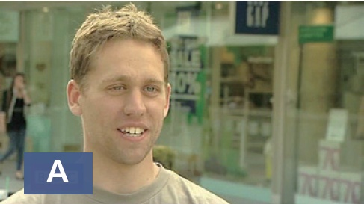
Listening to the world
Sharing
4
Watch Part 3 and fill in the blanks.
1 Where’s his mobile phone?
Answer:
________________________
In his pocket.

Slide 19
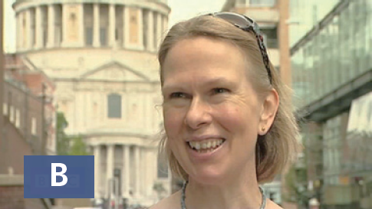
Listening to the world
Sharing
4
Watch Part 3 and fill in the blanks.
2 What’s her mobile phone connected to?
Answer:
_______________________
Twitter.

Slide 20
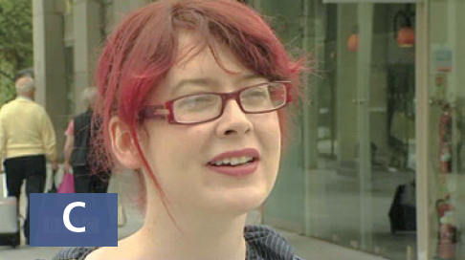
Listening to the world
Sharing
4
Watch Part 3 and fill in the blanks.
3 Why isn’t she using her iPod?
Answer:
_______________________
Because it’s not charged.

Slide 21

Listening to the world
Sharing
4
Watch Part 3 and fill in the blanks.
4 Which items of technology does he have with him?
Answer:
_______________________
_______________________
His mobile phone and an MP3 player.

Slide 22
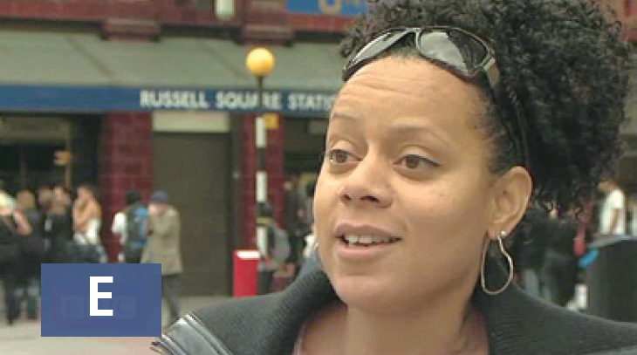
Listening to the world
Sharing
4
Watch Part 3 and fill in the blanks.
5 How many mobiles has she got?
Answer:
_______________________
Two.

Slide 23

Listening to the world
Sharing
4
Watch Part 3 and fill in the blanks.
6 What gadgets does he have?
Answer:
_______________________
_______________________
An e-book reader, a laptop, an iPod, and lots of gadgets.

Slide 24

Listening to the world
Sharing
5
Watch Part 4 and fill in the blanks.
I couldn’t live without my computer. Um, why not? Because I’m 1) _______________. It broke down once for three weeks and I felt like 2) ____________ had left me – I’m not even married.
on it all the time
my husband

Slide 25

Listening to the world
Sharing
5
Watch Part 4 and fill in the blanks.
I couldn’t live without 3) _____________. I could probably live without my 4) _______. I quite like leaving it turned off for a while. But er, the laptop’s 5) ____________.
my laptop
phone
essential

Slide 26
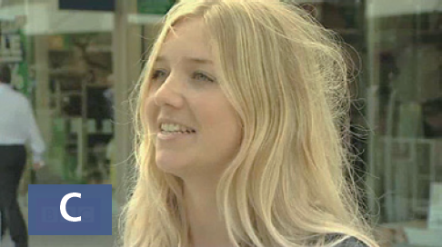
Listening to the world
Sharing
5
Watch Part 4 and fill in the blanks.
My phone. I think 6) ______________, I don’t need anything else.
beyond that

Slide 27

Listening to the world
Sharing
5
Watch Part 4 and fill in the blanks.
I don’t think I could live without my
mobile phone. And I couldn’t live without the 7) ____________, and I couldn’t live without the 8) _________– because I depend on them.
computer
Internet

Slide 28
Listening to the world
Sharing
6
Work in pairs and discuss the questions.
1 How do you feel about technology?
Technology is new and innovative, which can make life easier and more comfortable. I love technology and I spend a lot of money on technology.

Slide 29
Listening to the world
Sharing
6
Work in pairs and answer the questions.
2 What items of technology do you have with you at the moment?
I have two iPhones in my pocket and a laptop in my backpack.

Slide 30
Listening to the world
Sharing
6
Work in pairs and answer the questions.
3 What items of technology could / couldn’t you live without? Why?
I think I could live without an MP3 player. Now I often play music on my computer, so an MP3 player isn’t essential to me. I couldn’t live without my computer. I have to work on it every day. I search for useful information online, write drafts of my compositions, email them to my teachers, receive feedback and make changes accordingly. In my spare time, I surf on the Internet, write blogs, chat online with my friends, have video calls with my parents, and shop online. I depend on it.

Slide 31
Listening to the world
Sharing
Listening
Viewing

Slide 32
Listening to the world
Listening
BEFORE you listen
1
Work in pairs and answer the questions.
1 How much time do you spend on the Internet every day?
One to two hours a day.

Slide 33
Listening to the world
Listening
BEFORE you listen
1
Work in pairs and answer the questions.
2 What do you usually do when you surf the Internet?
I usually search for information, read news articles, shop online, or download music.

Slide 34
Listening to the world
Listening
BEFORE you listen
1
Work in pairs and answer the questions.
3 Do you get distracted when you work or study online?
Yes. When I search for certain information and open a new page, there are pop-ups related to news, sales information, new trailers, or something else. If it is something I’m interested in, I will click on it on impulse. So I’m vulnerable to these distractions.

Slide 35
Listening to the world
Listening
Listening skills
Additional Tips
Listening for agreement and disagreement One strategy is to listen for expressions showing agreement or disagreement. The speaker agrees with what other people say: I agree with your point, I’m with you on that point, That’s a good point, That’s true, I think you’re right, I think that is a good idea, etc…. The speaker agrees with what other people say: I disagree with your idea, I’m afraid I don’t agree, That’s not always true, That’s not always the case, I’m not sure about that, and You can’t actually mean that…

Slide 36
Listening to the world
Listening
Listening skills
Additional Tips
Listening for agreement and disagreement Another strategy is to recognize intonation patterns speakers use to indicate their attitudes. A falling-rising intonation using the symbol “↘↗” often conveys limited agreement, response with reservation, uncertainty, or doubt; And a rising-falling intonation, using the symbol “↗ ↘” often conveys a sense of strong agreement, or disagreement.

Slide 37
Listening to the world
Listening
WHILE you listen
2
Listen and check the true statements.
☐ 1 The men both use the Internet at work.
☐ 2 The woman thinks people shouldn’t use the Internet when they are at work.
☐ 3 The men both think that using the Internet is a waste of time.
√
√
(The men don’t think that using the Internet is a waste of time.)

Slide 38
Listening to the world
Listening
WHILE you listen
3
Listen and complete the answers to the questions.
1 According to the woman, what’s the problem with workers who use the Internet at work?
Answer: Lots of workers spend ___________________instead of doing their work.
all day on the Internet

Slide 39
Listening to the world
Listening
WHILE you listen
3
Listen and complete the answers to the questions.
2 According to the woman, why are some university students failing their degrees?
Answer: Because they spend all their time checking Facebook and ___________________________
watching the videos that friends
_________.
send them

Slide 40
Listening to the world
Listening
WHILE you listen
3
Listen and complete the answers to the questions.
3 Why do the men disagree with the woman’s opinion that people shouldn’t use the Internet at work for anything other than work?
Answer: Because they think using the Internet helps to ______________, just like having a cup of coffee or __________________________, or going to a bookshop or _______________ a pile of magazines.
give you a break
talking to someone in the office
looking through

Slide 41
Listening to the world
Listening
WHILE you listen
3
Listen and complete the answers to the questions.
4 In what way is reading books different from surfing on the Internet?
Answer: People aren’t addicted to _______________ but can be addicted to the Internet.
reading books

Slide 42
Listening to the world
Listening
WHILE you listen
3
Listen and complete the answers to the questions.
5 What problems do people who are addicted to the Internet have?
Answers:
1) They spend too much time ____________________.
2) They choose the Internet over _________________.
3) They forget how to _________________________.
in front of the computer
sports and going out
live in the real world

Slide 43
Listening to the world
Listening
AFTER you listen
4
Work in pairs and discuss the statements.
1 You shouldn’t believe what you read on the Internet.
I partly agree with the statement.
On one hand, we have to admit that the Internet enhances all our lives on a daily basis. We can search for information online, communicate with others. It also makes our work more convenient.
On the other hand, the Internet is a big platform, which allows everyone to express their own opinions, even release unreliable information or rumors. You may read false news, false statistics and made-up stories. It is impossible and unnecessary to conduct cyber-investigations all the time, but just be careful to check what you read online.

Slide 44
Listening to the world
Listening
AFTER you listen
4
Work in pairs and discuss the statements.
2 It’s better to talk to someone than to send them a text message.
I think it depends.
Traditionally, talking to someone face to face is a good way to show your sincerity and your attention. Besides, face-to-face talk can make you well understood and ensure the talk goes smoothly.
But, if you are too shy to make a request face-to-face, sending a text message will be a better choice. If you don’t receive any answer, it means the other person has declined politely. To most Chinese people this is the best strategy in order to avoid losing face.

Slide 45
Listening to the world
Listening
AFTER you listen
4
Work in pairs and discuss the statements.
3 Online books will mean the end of bookstores.
I do not totally agree with the statement.
Online books do not really mean the end of bookstores, but this new reading style indeed signals trouble for bookstores. Without doubt, there are many advantages of online books. They come at lower costs and save us from going to the shop, purchasing a book or wasting time on home delivery. They make our reading more convenient.

Slide 46
Listening to the world
Listening
AFTER you listen
4
Work in pairs and discuss the statements.
3 Online books will mean the end of bookstores.
But traditional bookstores still have their reason to exist. Although printed books are more expensive than online books, there are many people who stick to the tradition. We’re never going to get that comforting smell of paper or the weight of a good book in our hands when we read an online book. So, traditional bookstores will still be there. But, if we consider the book market as a whole, the market share of traditional books is getting smaller and smaller.

Slide 47
Listening to the world
Sharing
Listening
Viewing

Slide 48
Listening to the world
Viewing
BEFORE you view
1
Read the program information below and answer the questions.
1 What do you think the children will do when their televisions and video games are taken away?
I think after televisions and video games are taken away, children’s attention will go to other indoor and outdoor activities. For indoor activities, they can play with toys, they can play cards, puzzles and so on; for outdoor activities, they can engage themselves in gardening, boating, camping etc. So without TV, children will have more interesting and fun things to do.

Slide 49
Listening to the world
Viewing
BEFORE you view
1
Read the program information below and answer the questions.
2 How do you think the parents will feel during the experiment?
Maybe at the very beginning, the kids will feel bored and uncomfortable, and the parents have to spend more time playing with the kids. But with the going of the experiment, when the parents find most kids can adjust themselves to the new life very well, and there is more laughter and happiness derived from the absence of TV, the parents may feel relieved.

Slide 50
Listening to the world
Viewing
WHILE you view
2
Watch the video clip and check the true statements.
☐ 1 Some people believe that children who watch too much TV get fat.
☐ 2 The program Panorama went to a secondary school in Manchester.
☐ 3 The children were given a camera to record what would happen.
√
(The program Panorama went to a primary school in Manchester.)
(Each family was given a camera to film what would happen.)

Slide 51
Listening to the world
Viewing
WHILE you view
2
Watch the video clip and check the true statements.
☐ 4 The parents had to work a lot harder when there were no TVs.
☐ 5 After the experiment, the families watched the same amount of TV as before.
√
(After the experiment, the families watched less TV than they did before.)

Slide 52
Listening to the world
Viewing
WHILE you view
3
Watch the whole video clip again and choose the best answer to each question.
C
1 Why do some people suggest TV should be banned?
A Because kids cannot learn from TV.
B Because TV makes people addicted.
C Because TV does a lot of harm to kids.
D Because parents cannot live without TV.

Slide 53
Listening to the world
Viewing
WHILE you view
3
Watch the whole video clip again and choose the best answer to each question.
B
2 How much time do children spend watching TV?
A Children watch 32 whole days of television in the year when they are nine.
B Children watch 32 whole days of television in the year when they are eight.
C Children watch 84 whole days of television in the year when they are nine.
D Children watch 84 whole days of television in the year when they are eight.

Slide 54
Listening to the world
Viewing
WHILE you view
3
Watch the whole video clip again and choose the best answer to each question.
D
3 In this experiment, what will not be removed from people’s homes?
A The TV.
B The PC.
C The video games.
D The microwave.

Slide 55
Listening to the world
Viewing
WHILE you view
3
Watch the whole video clip again and choose the best answer to each question.
D
4 Why do the parents have to work harder without TV?
A They have to teach their kids to count numbers.
B They have to earn more money to buy games for their kids.
C They have to cook more delicious food for their kids.
D They have to spend more time playing with their kids.

Slide 56
Listening to the world
Viewing
WHILE you view
3
Watch the whole video clip again and choose the best answer to each question.
C
5 What long-term effect does the experiment have on the participating families?
A They don’t watch TV in the morning anymore.
B They have stayed away from TV since then.
C They have a much better family atmosphere.
D They spend more time watching news on TV.

Slide 57
Listening to the world
Viewing
AFTER you view
4
Work in pairs and discuss the questions.
1 Do the parents think the experiment is positive? Why or why not?
Yes. Most of the parents thought the experiment was positive. Because without any TV, there was more laughter in the house and they were more of a family.

Slide 58
Listening to the world
Viewing
AFTER you view
4
Work in pairs and discuss the questions.
2 What do you think of the experiment? Do you think it is a good idea?
I think the experiment is very good. Over the last 30 years, TV has become an important part of our family life. It is also criticized for its potential to promote aggressive and negative behavior, to provide negative and inappropriate role models to our children, and to create negative values such as the values of consumption and possession. But is it wise to allow TV watching to become a subject for confrontation? We need such a kind of experiment to see the influence of TV clearly.

Slide 59
Listening to the world
Viewing
AFTER you view
4
Work in pairs and discuss the questions.
3 Is TV a blessing or a curse? Why?
Nowadays watching TV has become a very important part of many people’s family life. As is known to us, television presents a vivid and colorful world for people. Through TV, people can be better informed of the latest developments across the world. In this sense, TV is a blessing. However, television can also be a curse. Various TV programs are likely to make people become “couch potatoes”. As a result, their health, study, work, and even life could be severely affected. So, in my opinion, whether TV is a blessing or a curse depends on your own personal view.

Slide 60

Speaking for communication
Role-play
1
Listen to the conversation and complete the table.

Slide 61
Speakers | Gadgets | Essential | Not essential | Reasons
1 | Mobile phone |  |  | I use it 1) _____________ I love talking to people, and 2) _______.
 | MP3 player |  |  | ∕
 | Television |  |  | I don’t 3) ___________________.
 | Digital camera |  |  | I’m 4) ________at taking photos anyway.
 | Laptop |  |  | I use my laptop 5)__________, so yes, I need that.
2 | Mobile phone |  |  | I need it in case there’s 6) _____________and I have to call someone. Or if there’s 7) _________ with one of the children.
 | TV |  |  | ∕
 | Laptop |  |  | I need a computer to 8) _________________and keep in touch with people.
 | Digital camera |  |  | 9) ________________can take the photos!
 | MP3 player |  |  | ∕
all the time
√
texting
√
√
watch much television
terrible
√
for work
√
√
an emergency
a problem
√
√
go on the Internet
√
Someone else
√

Slide 62
Speaking for communication
Role-play
2
Listen to the conversations again and match the statements.
Speakers | Gadgets | Expressions
1 | 1) Mobile phone | a I suppose it’s not essential
 | 2) MP3 player | b Not essential.
 | 3) Television | c I couldn’t live without …
2 | 1) Mobile phone | a That’s essential really.
 | 2) TV | b I don’t go anywhere without …
 | 3) Digital camera | c I suppose I don’t need that.

Slide 63
Speaking for communication
Role-play
Speaking skills
Additional Tips
Expressing essentiality Using different expressions, you may show different attitudes toward things according to the degree of essentiality they’ve displayed in your life. For example, if you are a music lover, you may find an iPod very important to you, so you can use expressions like I need it, I use it every day, I can’t live without it, etc. On the contrary, suppose you are persuaded to buy a camera, but actually you are not very interested in photography, then you may use expressions like (I suppose) I don’t need it, I can live without it, etc.

Slide 64
Speaking for communication
Role-play
Speaking skills
Additional Tips
Expressing essentiality
Essential | Not essential
• That’s essential. • … is essential to … • I use it all the time / every day. • I couldn’t live without … • It’s good / important because … • I take it everywhere • I need it in case … • It’s very useful. | • I can go without … • I can do without … • I suppose it’s not essential …

Slide 65
Speaking for communication
Role-play
3
Work in pairs and role-play the situations.
Situation 1
What electronic gadgets should we buy?
A: The mobile phone is essential to me. I can’t live without it. I need it in case there’s an emergency and I have to call someone. B: I can’t live without the mobile phone, either. I’m a secretary, and I need it just in case my boss calls me. So we’ll buy two mobile phones. How about the laptop? A: I’m a designer. The laptop is very important for my job. Without it, my career would be ruined.

Slide 66
Speaking for communication
Role-play
3
Work in pairs and role-play the situations.
Situation 1
What electronic gadgets should we buy?
B: So a laptop is essential. MP3 player? I love music. I can’t bear the thought of life without it. So an MP3 player is the gadget I must have. A: The DVD player is out-of-date. I usually watch movies on the Internet. It’s much more convenient. Besides if I want to do some editing, most DVD players can’t help now. I must turn to some popular computer programs on the Internet. So I think we don’t need one.

Slide 67
Speaking for communication
Role-play
3
Work in pairs and role-play the situations.
Situation 1
What electronic gadgets should we buy?
B: Digital camera? I want one. I’m not a photographer, but I love to film every important person and moment in my life. So a digital camera is a good help. I feel proud and happy when I watch those videos I’ve made. A: Digital TV? I suppose I don’t need a digital TV. Although it can provide much clearer and higher-quality pictures, it has rather limited programs to choose from. I think it will be replaced by the Internet or some other technology in the future.

Slide 68
Speaking for communication
Role-play
3
Work in pairs and role-play the situations.
Situation 1
What electronic gadgets should we buy?
B: The iPad is a new gadget. Many people are mad about it and I am one of them. The first thing I do when I open my eyes every day is to turn on my iPad. I can’t live without it. Do you want one, too? A: No, I don’ think the iPad is essential. But I’m addicted to the games on the PSP. I don’t go anywhere without it. So I want to have a PSP instead.

Slide 69
Speaking for communication
Role-play
3
Work in pairs and role-play the situations.
Situation 2
What stationery items should we buy?
A: I take eight courses this semester, so I need eight notebooks. B: I suppose I don’t need so many notebooks. Two will do. But I need some exercise books. Do you want some? A: Yes, I need two just in case. What else do you need? B: Highlighters. I love them. I always use them to highlight important parts in books.

Slide 70
Speaking for communication
Role-play
3
Work in pairs and role-play the situations.
Situation 2
What stationery items should we buy?
A: I don’t think that’s essential for me. I don’t like marking books with highlighters. B: Do you need some pencils? A: I don’t use pencils anymore. I use pens instead. B: But we do need to use pencils to mark answers on the Answer Sheet in exams.

Slide 71
Speaking for communication
Role-play
3
Work in pairs and role-play the situations.
Situation 2
What stationery items should we buy?
A: Oh, yes, you’re right. Pencils are definitely essential. So are the erasers. B: Yes, they are useful. A: How about rulers? Do you want one? B: No, I think I can do without one.

Slide 72
Speaking for communication
Group discussion
Get ideas
1
Listen to a passage and complete the notes.
Day 1
1 I choose 1) ____________ characters and go to Blazing Falls.
2 We build a house 2) ____________________.
3 When I’ve finished, I have a feeling of
3) ____________________.
two
near the sea
real achievement

Slide 73
Speaking for communication
Group discussion
Get ideas
1
Listen to a passage and complete the notes.
Day 2
12
1 I walk into a house with 4) ____________ people.
2 I feel nervous because I’ve never 5) ____________
to strangers before.
3 I type “6) ____________”. No one answers. I feel uncomfortable and 7) ____________.
4 I type something again, feeling like 8) _________ at school who nobody wants to talk to.
5 I get 9) ____________ and leave to talk to
10) ____________________.
talked online
hello
lonely
a new girl
bored
my real friends

Slide 74
Speaking for communication
Group discussion
Get ideas
1
Listen to a passage and complete the notes.
Day 3
a club
1 I send Troy into 11) _______________.
2 He is 12) ______________ so when he walks in, people 13) ____________________.
3 I’m 14) ____________________ with my new friends. In real life, I 15) _____________________ for ages. I’m amazed by the good feeling I get.
good-looking
start talking to him
on the dance floor
haven’t been dancing

Slide 75
Speaking for communication
Group discussion
Discuss and organize ideas
2
Work in groups and discuss the following questions.
1 What computer games do you usually play?
Usually I play Angry Birds.
2 Why do you like playing these games?
It’s a good way to kill time and relax myself.

Slide 76
Speaking for communication
Group discussion
Discuss and organize ideas
2
Work in groups and discuss the following questions.
3 What new experiences do you have in the games?
It’s easy for me to pick up. Besides, it makes me feel better when I am angry.
4 Whose experiences in computer games impress you the most? Why?
X’s. I have never played games for more than two hours, but X played from Thursday night and through the whole weekend. I just couldn’t imagine it.

Slide 77
Speaking for communication
Group discussion
Discuss and organize ideas
3
Prepare for a presentation using the following outline.
The name of the computer game
The reasons for playing the game
The things people can do in the game
The new / different experiences people may have in the game
How I feel about the experiences
My opinions on computer games

Slide 78

Speaking for communication
Group discussion
Present ideas
4
Present the most impressive experiences of playing computer games to the class.

Slide 79
Further practice in listening
Short conversations
1 Q: What does the woman suggest the man do?
B Search for information on the Internet.
2 Q: What do you think Mr. Johnson will most probably do?
C He will tell his son not to take his phone to school.
3 Q: What does the woman say about people aged 50 to 65?
D They are not very likely to get involved in online dating.
4 Q: What does Jennifer want to know?
D Which online platform suits her needs.
5 Q: What does the woman imply?
C The man’s personal information was leaked online.

Slide 80
Further practice in listening
Long conversation
1 Q: What did the man do for his grandmother?
B He taught his grandmother how to use electronic gadgets.
2 Q: What problem does the man’s grandmother have?
B She is unable to use her household electronic items.
3 Q: What do the man’s grandmother and the woman’s aunt have in common?
A They are both reluctant to learn how to use electric items.
4 Q: What will the man do to help his grandmother?
C Try to make her interested in electronic items.

Slide 81
Further practice in listening
Passage 1
Listen to a passage and choose the best answer to each question.
1 Q: What does the writer compare “wilfing” to?
D Window shopping.
2 Q: What websites are the most popular among wilfers?
A Shopping websites.
3 Q: What did the poll find out about wilfing?
A People under 25 were more likely to wilf than those aged 55 and above.
4 Q: How do adult entertainment websites attract users?
D By using pop-up technology and bulk emails.

Slide 82
Further practice in listening
Passage 2
Listen to a passage three times and fill in the blanks.
The New York Police Department (NYPD) announced it will form a new unit to search social media as part of the combined efforts against criminals. This is an official
1) __________ to criminals’ growing use of some websites to plan and celebrate 2) ___________ achievements.
A police chief, Kevin O’Connor, is 3) _____________ an NYPD unit created specifically to comb social media sites like Facebook, Twitter, and BlackBerry Messenger for information on planned crimes and their offenders.
response
illegal
in charge of

Slide 83
Further practice in listening
Passage 2
The efforts against criminals have linked social media to increasing incidents of robberies in the United States and the recent rioting in London. Public safety agencies are
4) ____________ looking to step up their efforts in order to better protect citizens against these trends.
In the London riots in particular, the police suspect the rioters
5) _________________ BlackBerry Messenger to coordinate and plan their riots. Police there are working with BlackBerry Messenger to identify those messages that are
6) ____________ burning and robbing London stores.
consequently
relied heavily on
linked to

Slide 84
Further practice in listening
Passage 2
BlackBerry Messenger and other smartphone messaging services make it hard for the police to 7) ____________ criminal activity, especially if they aren’t as
8) _______________ the technology as the offenders are. The NYPD unit intends to educate officers about such technology to 9) ________ this defect.
For social media providers and smartphone makers, the criminals’ preference for their products is putting them in the sticky position of determining how to assist police efforts without 10) ____________ lawful customers’ privacy.
anticipate
familiar with
remedy
betraying

Slide 85
Wrapping up
Use the following self-assessment checklist to check what you have learned in this unit.
 | OK | Needs work
I can talk about my technology and its influence on our lives.
I can listen for agreement and disagreement.
I can use a variety of expressions to talk about essentiality.
I can talk about my experiences and feelings of playing computer games.

Slide 86
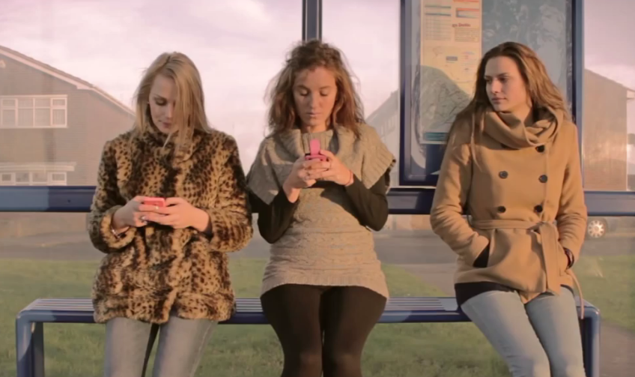
Fun time
Enjoy the video clip.

